Slide 1
Year 11
Homework Login Support
Email: Homework@hartshillacademy.org.uk
Or see Mr Allison in the IT office.

Slide 2
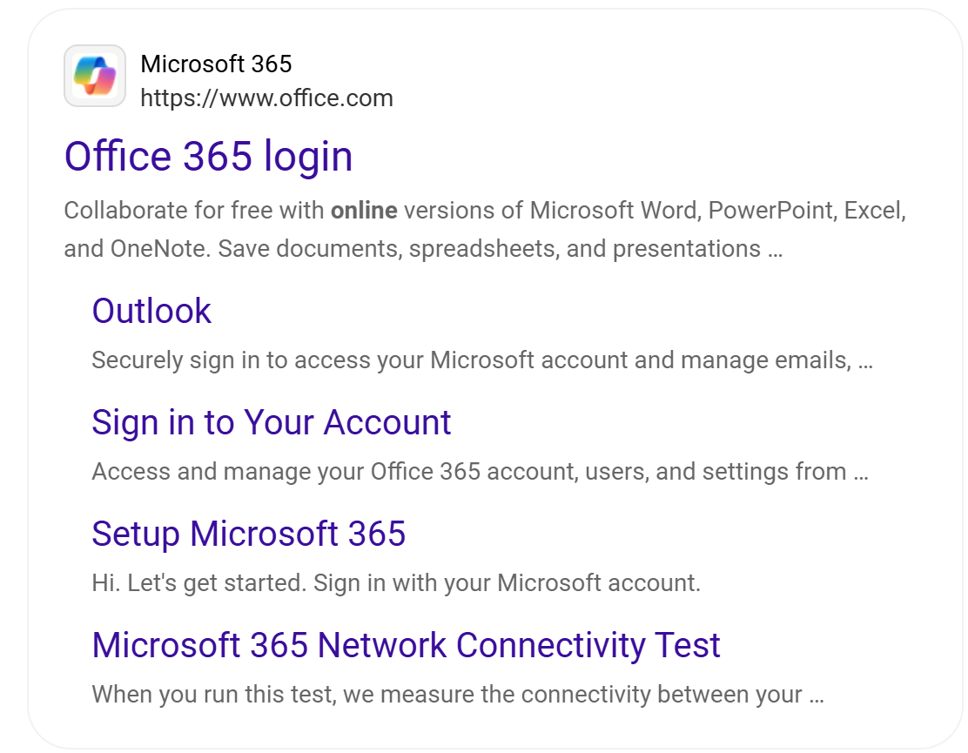
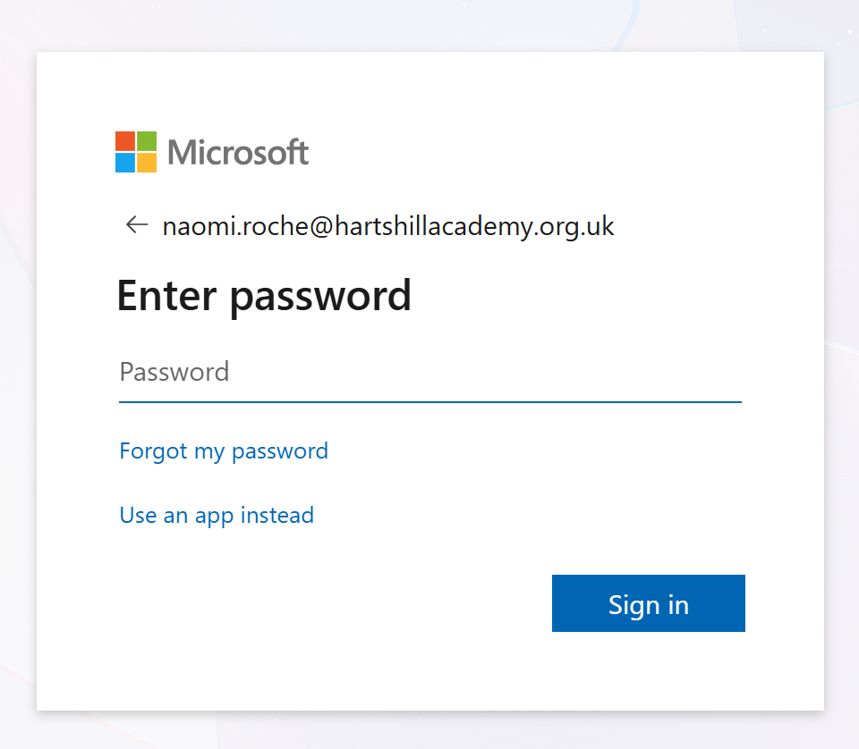
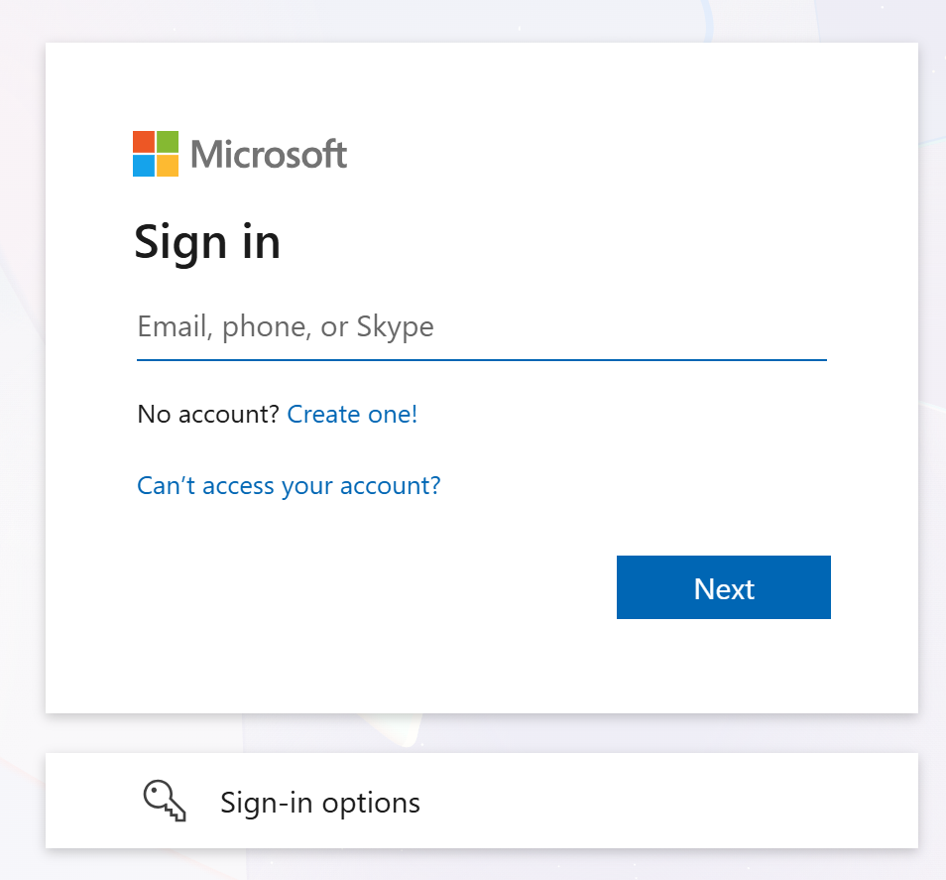
Microsoft 365 First Login
Step 1:
Google ‘Office 365’
Step 3:
Enter your Password
If you have forgotten your password, you must see Mr Allison in the IT office to support with a reset.
Step 2:
Enter your school email address
Step 4:
You must remember it.

Slide 3
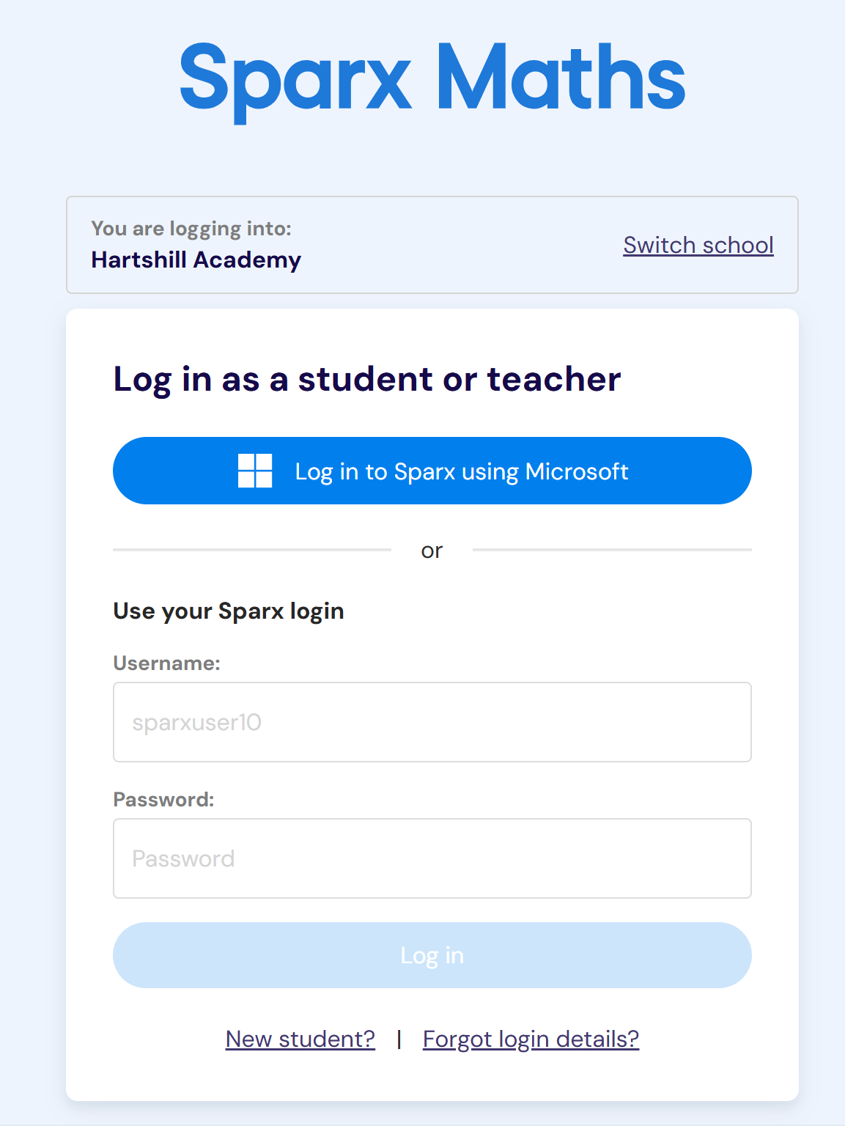
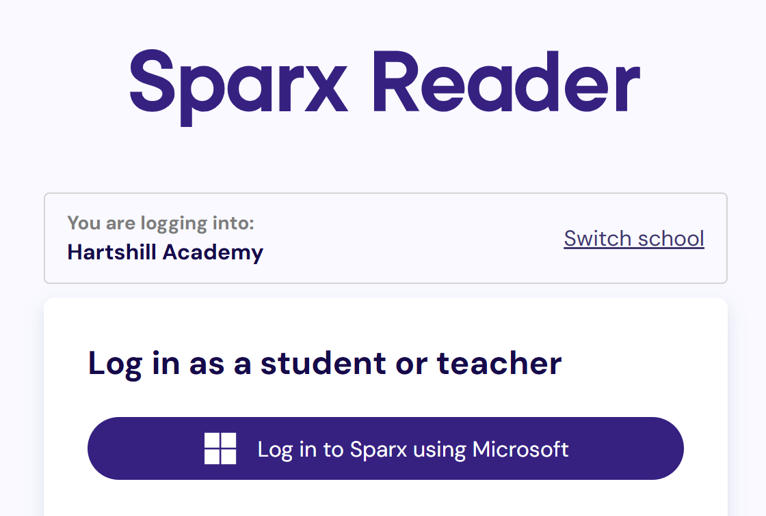
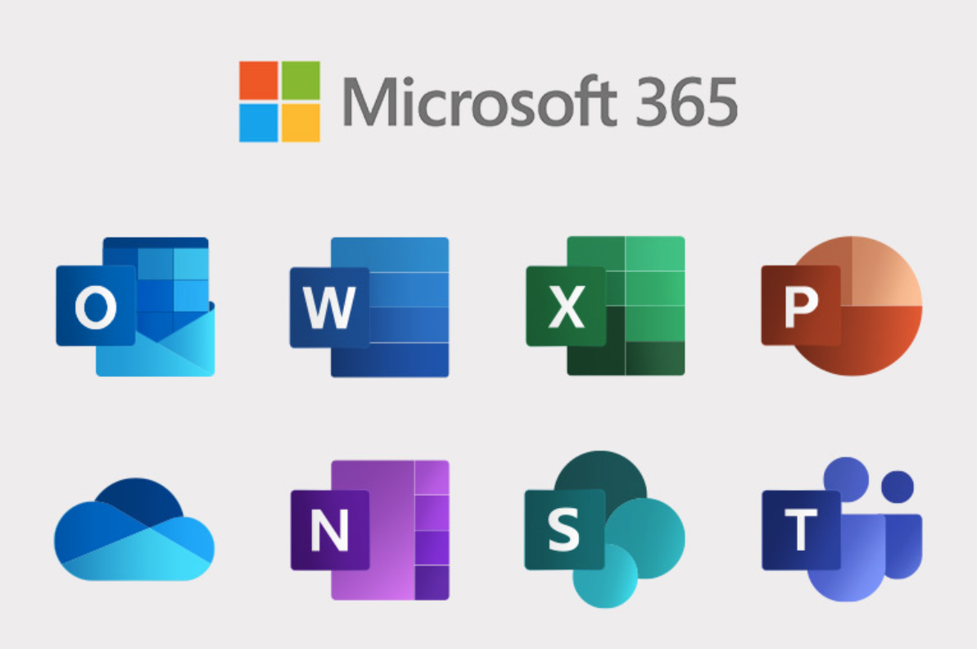

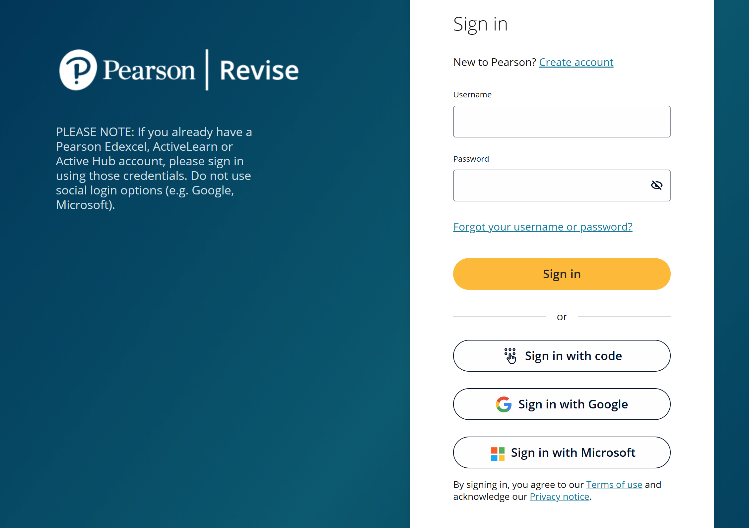
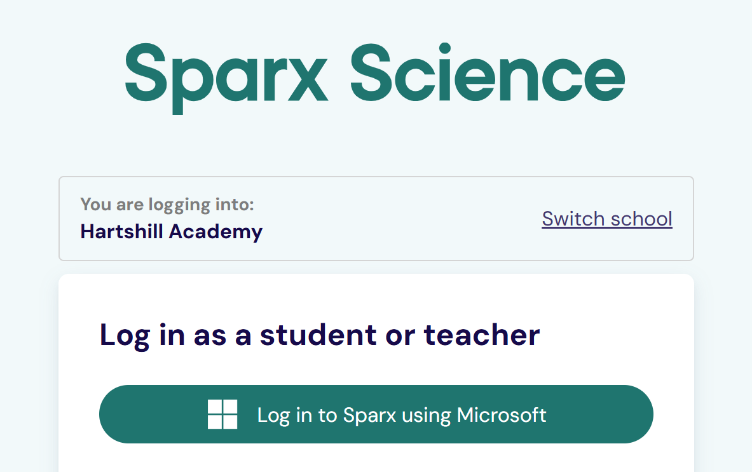

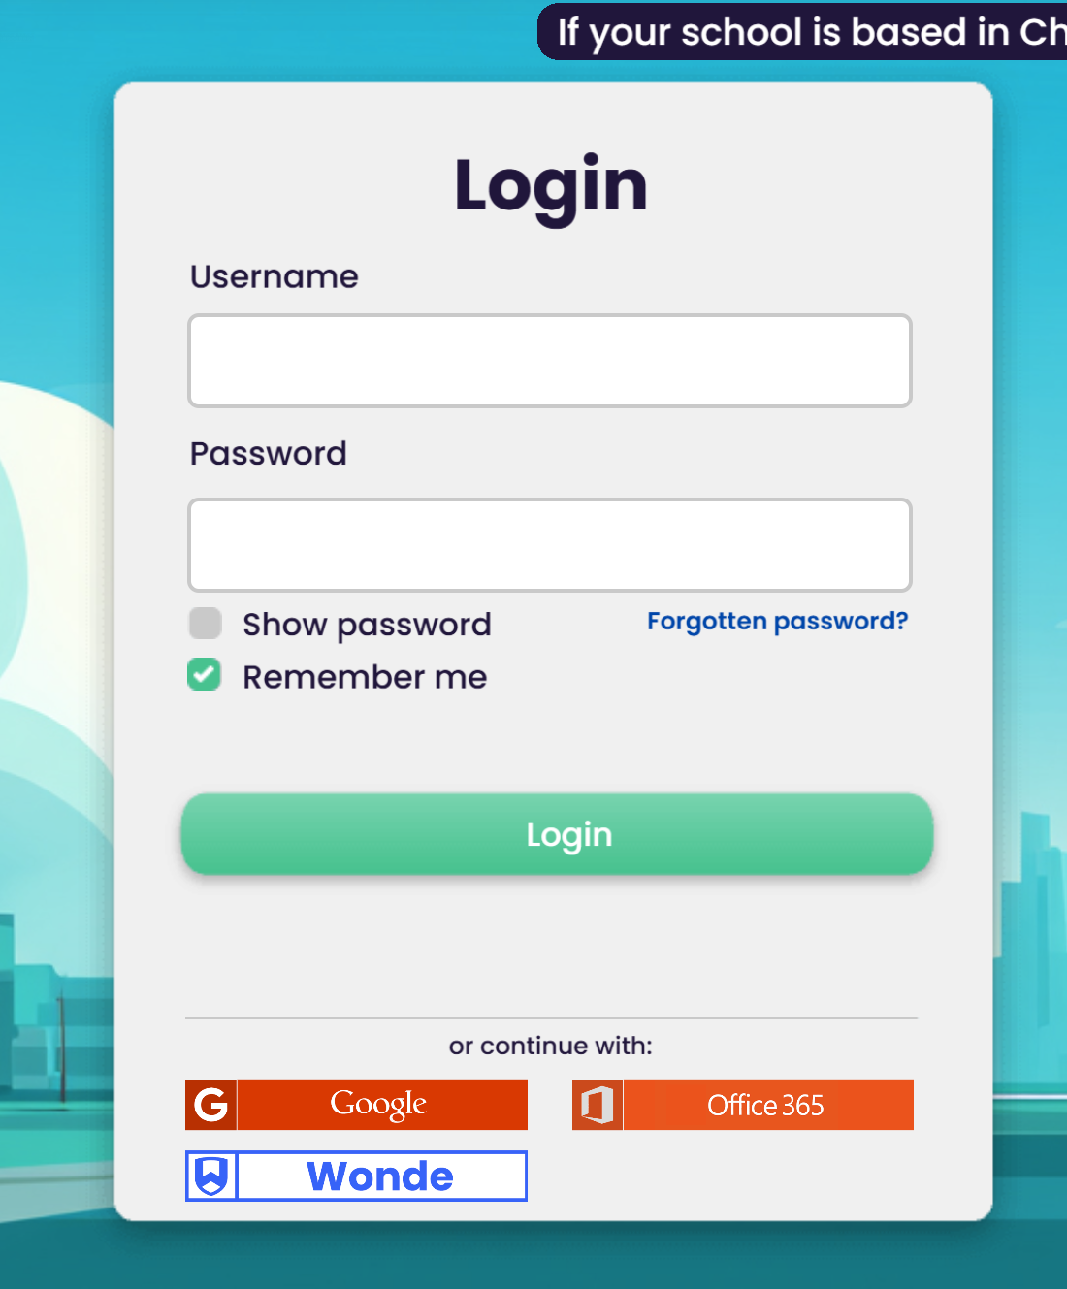
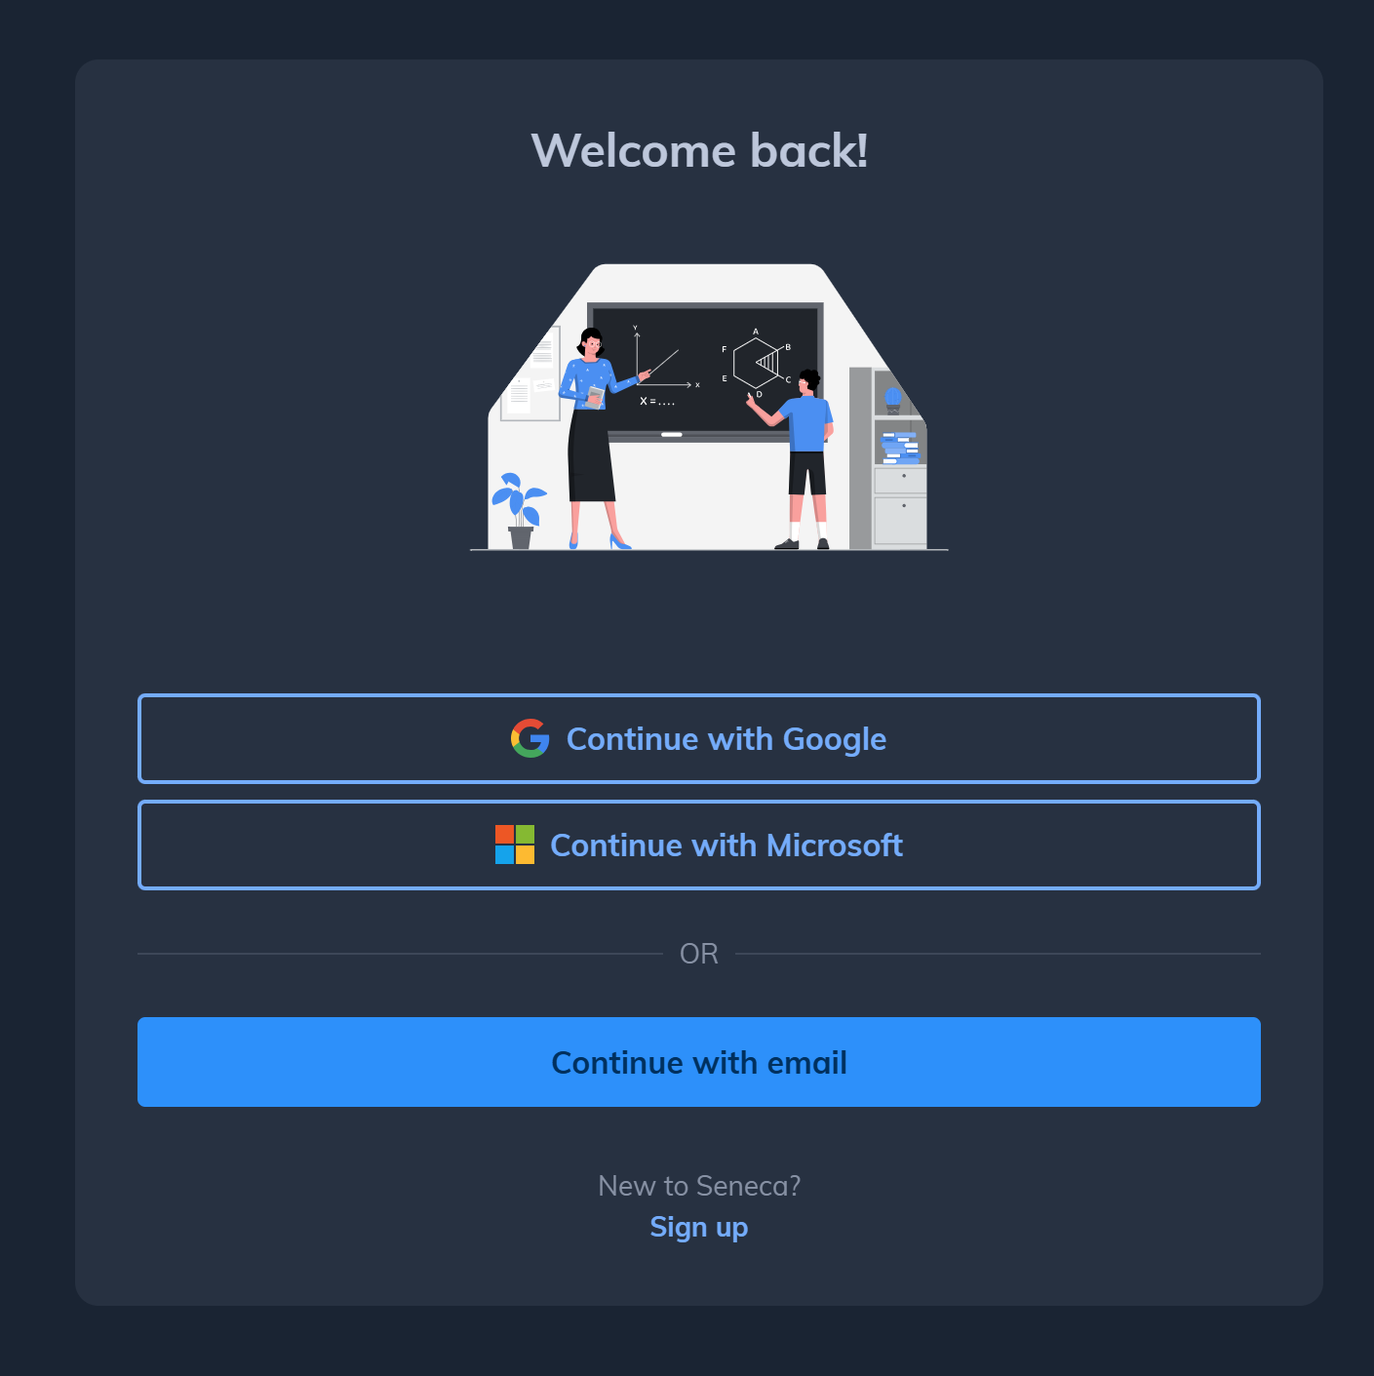

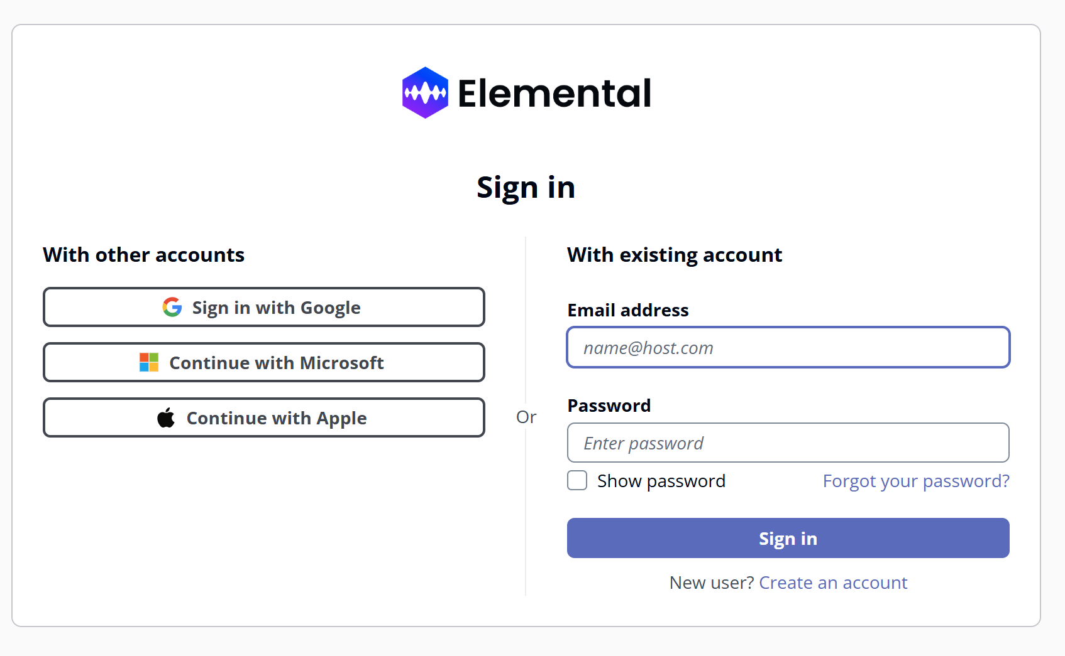
Homework platforms
You can now sign in to all platforms using your Microsoft login.

